Slide 1
Numerical Analysis
Seminar Session 4
Russell Kabir, PhD

Slide 2

Contents
Hypothesis
Correlation
Assignment Guidelines
Questions and Answers

Slide 3
Session to be recorded
Please turn on microphone to talk or type in the chat box.
If not talking, please keep microphone on mute.
There will be opportunity for questions at the end too.

Slide 4
Hypothesis
Hypotheses are generalizations concerning differences in patterns and associations in populations” (Polgar & Thomas, 2000)
“the process of deciding statistically whether the findings of an investigation reflect chance or real effects at a given level of probability” (Polgar & Thomas, 2000)
To reject or not to reject?

Slide 5
Null hypothesis (Ho) – there is no difference between the variables under investigation
Alternative hypothesis (H_{A} ) – the prediction intended for evaluation, that there is a difference between groups
A researcher always tests the null hypothesis with the hope of rejecting it

Slide 6
Association between two variables: Bivariate analysis
Two types of variables: Categorical and Quantitative
We may have the following combinations for bivariate analysis (i.e., association between):
Categorical and Quantitative variables
Categorical and Categorical variables
Quantitative and Quantitative variables

Slide 7
Association between a Categorical and a Quantitative variable (Cat vs Quan):
Categorical Vs Quantitative var | Quantitative var
 | Normal | Non-normal
Categorical var has two levels (e.g., disease present, disease absent) | Independent samples t-test | Mann-Whitney U test
Categorical variable has >2 levels (e.g., Muslim, Hindu, Christian, Others) | ANOVA | Kruskal Wallis test
Quantitative measurements before and after (related sample) | Paired t-test | Wilcoxon signed rank test

Slide 8
Association between two categorical variables (Cat vs Cat):
Chi-square test, or
Fisher’s Exact test (if expected cell value is <5 in >20% cells)
Association between ordinal and nominal variables
Use Chi-square for tend (Linear by Linear) p-value
Association between two quantitative variables (Quan vs Quan):
Pearson’s correlation, if both the variables are normally distributed
Spearman’s Correlation, if any one or both are non-normal

Slide 9
Practice Work
One Sample t-test
data: Health_Data$dbp
t = 3.4124, df = 209, p-value = 0.0007732
alternative hypothesis: true mean is not equal to 80
95 percent confidence interval:
81.16832 84.36502
sample estimates:
mean of x
82.76667

Slide 10
Interpretation
t is the t-test statistic value (t = -3.4124),
df is the degrees of freedom (df= 209),
p-value is the significance level of the t-test (p-value = 0.00)
conf.int is the confidence interval of the mean at 95% (conf.int = [81.1683, 84.3650]);
sample estimates is the mean value of the sample (mean = 82.77).
The p-value of the test is 0.00 which is less than the significance level alpha = 0.05. We can conclude that the mean diastolic BP of participants is different from 80 mmHg.

Slide 11
Practice Work
Paired t-test
data: before and after
t = -15.092, df = 31, p-value = 7.84^{16})
alternative hypothesis: true difference in means is not equal to 0
95 percent confidence interval:
-42.46114 -32.35136
sample estimates:
mean of the differences
-37.40625

Slide 12
Interpretation
t is the t-test statistic value (t = 15.09),
df is the degrees of freedom (df= 31),
p-value is the significance level of the t-test (p-value = 7.84^{16}).
conf.int is the confidence interval (conf.int) of the mean differences at 95% is also shown (conf.int= [-42.461, -32.351])
sample estimates is the mean differences between pairs (mean = -37.406).
The p-value of the test is 7.84^{16}, which is higher than the significance level alpha = 0.05. We can then accept null hypothesis and conclude that the there is no difference in the mean scores before and after the training.

Slide 13
What is correlation?
Correlation is a statistical measurement of the relationship between two variables
Types of variable
Independent variable is a variable that can be controlled or manipulated
whereas
Dependent variable is a variable that cannot be controlled or manipulated. Its values are predicted from the independent variable

Slide 14
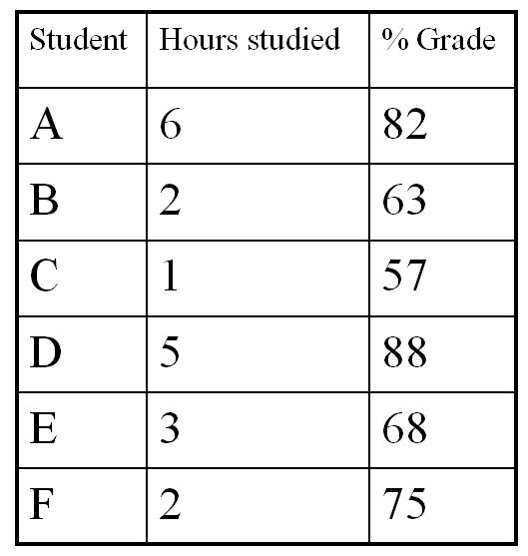
Correlation example
Independent variable in this example is the number of hours studied.
The grade the student receives is a dependent variable.
The grade student receives depend upon the number of hours he or she will study.
Are these two variables related?

Slide 15
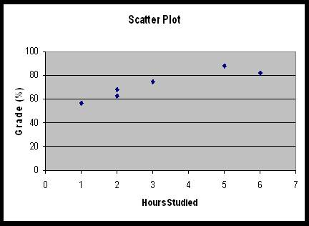
Scatter Plot
The independent and dependent can be plotted on a graph called a scatter plot.
By convention, the independent variable is plotted on the horizontal x-axis. The dependent variable is plotted on the vertical y-axis.
The graph suggests
a positive relationship
between hours of
studies and grades

Slide 16
Correlation coefficient
The correlation coefficient computed from the sample data measures the strength and direction of a relationship between two variables.
The range of the correlation coefficient is.
- 1 to + 1 and is identified by r.
Types of correlation
A positive relationship exists when both variables increase or decrease at the same time. (Weight and height).
A negative relationship exist when one variable increases and the other variable decreases or vice versa. (Strength and age).

Slide 17
Positive Correlation
In case of exact positive linear relationship the value of r is +1.
In case of a strong positive linear relationship, the value of r will be close to + 1.
Negative Correlation
In case of exact negative linear relationship the value of r is -1.
In case of a strong negative linear relationship, the value of r will be close to - 1.
Poor correlation
In case of a weak relationship the value of r will be close to 0.

Slide 18
Questions and Answers
Notes:
R=0.89,
R=-.79

